Slide 1
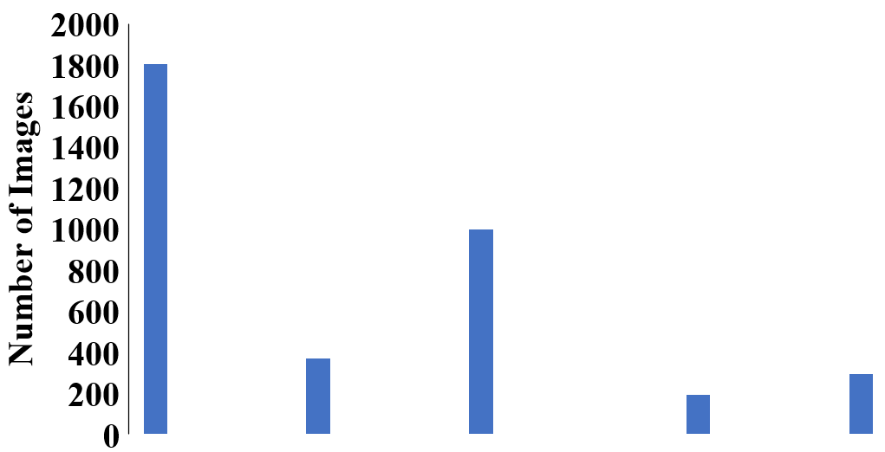
0
1
2
3
4
DR Severity in Fundus Images

Slide 2
Conv. Layer 1
In channels: 3
Out channels: 32
Conv. Layer 2
In channels: 32
Out channels: 128
Conv. Layer 3
In channels: 128
Out channels: 256
Conv. Layer 3
In channels: 256
Out channels: 512
Convolutional Layers
Global Average Pooling Layer
Dropout Layer
AvgPool2D layer
Layer 1
In channels: 512
Out channels: 128
Layer 2
In channels: 128
Out channels: 32
Layer 3
In channels: 32
Out channels: ~
Fully Connected Layers

Slide 3
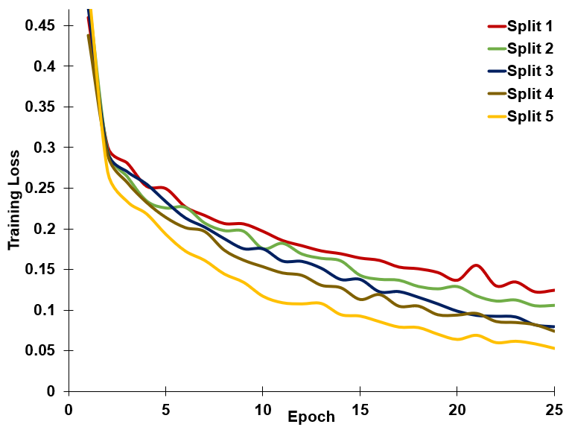
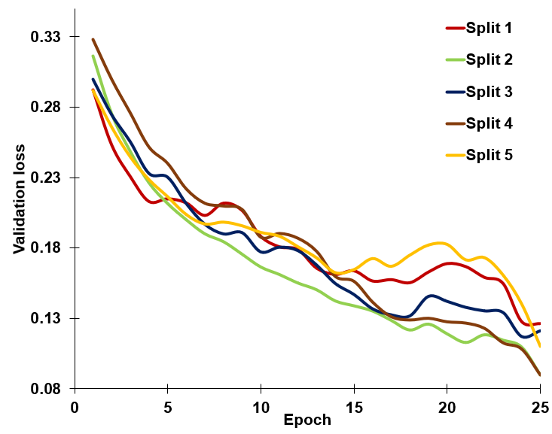

Binary
A
B

Slide 4
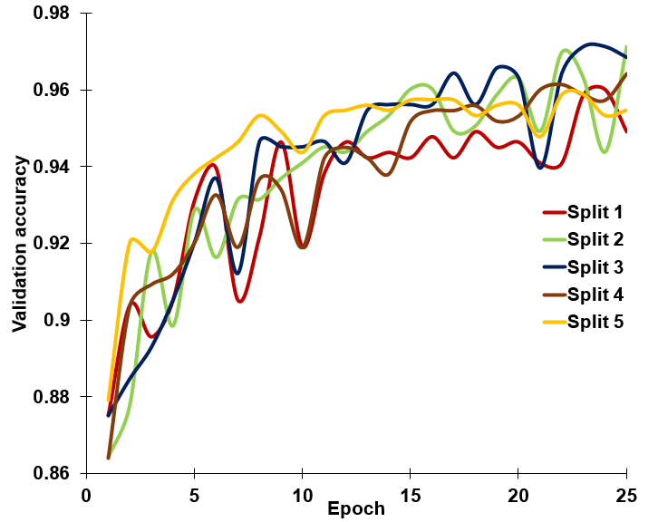
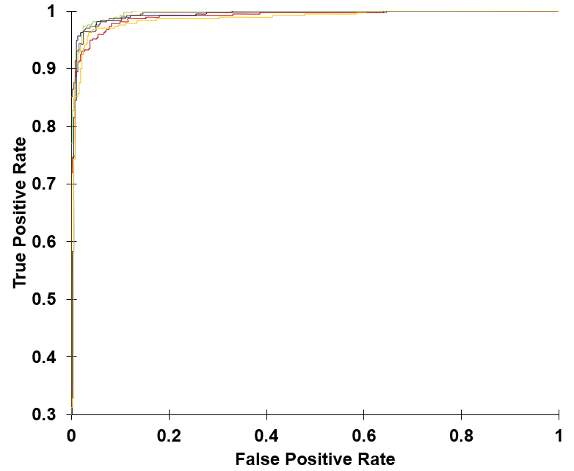
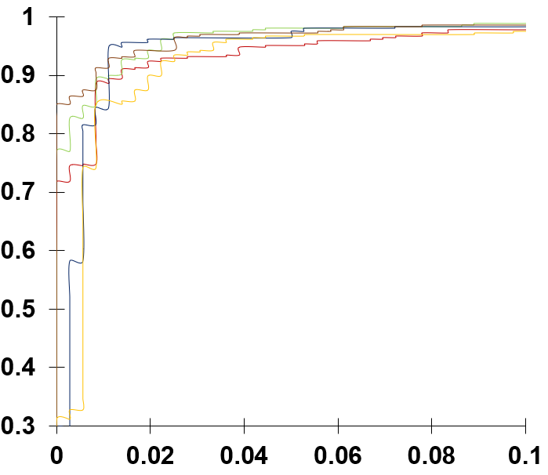
Binary
A
B

Slide 5
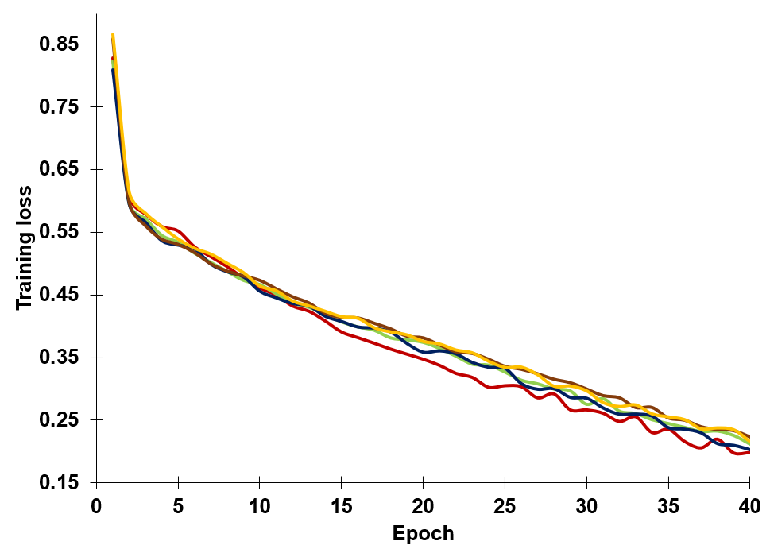
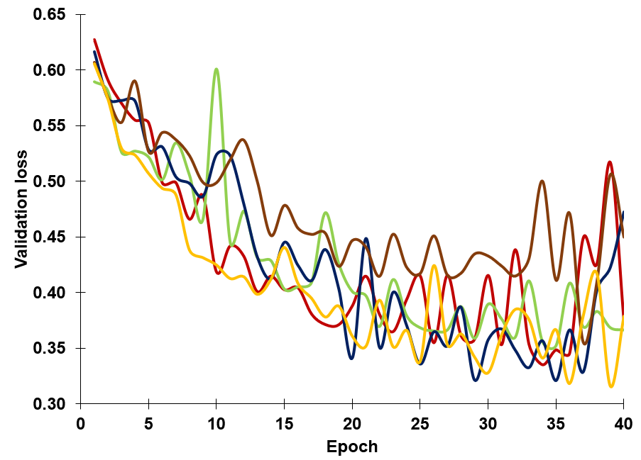
Early
A
B

Slide 6
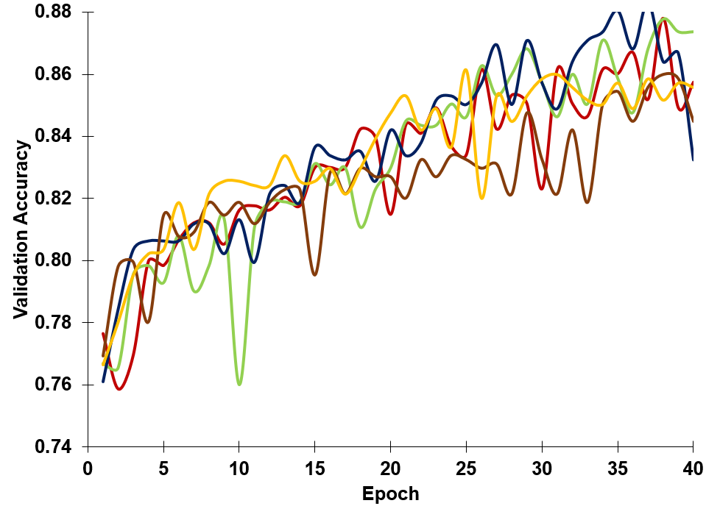
Early

Slide 7
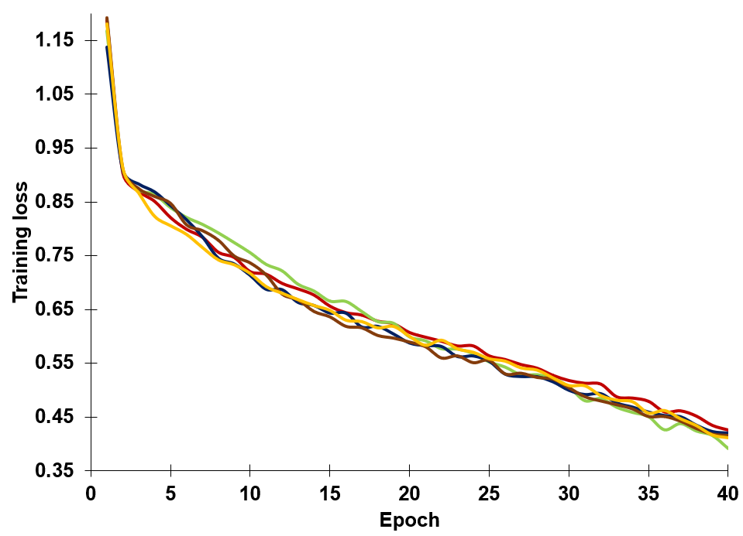
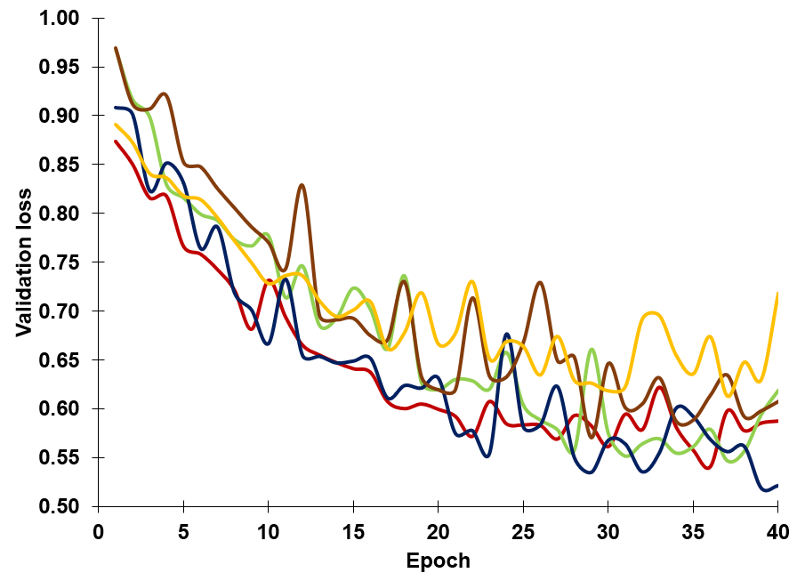
Severity detection
A
B

Slide 8
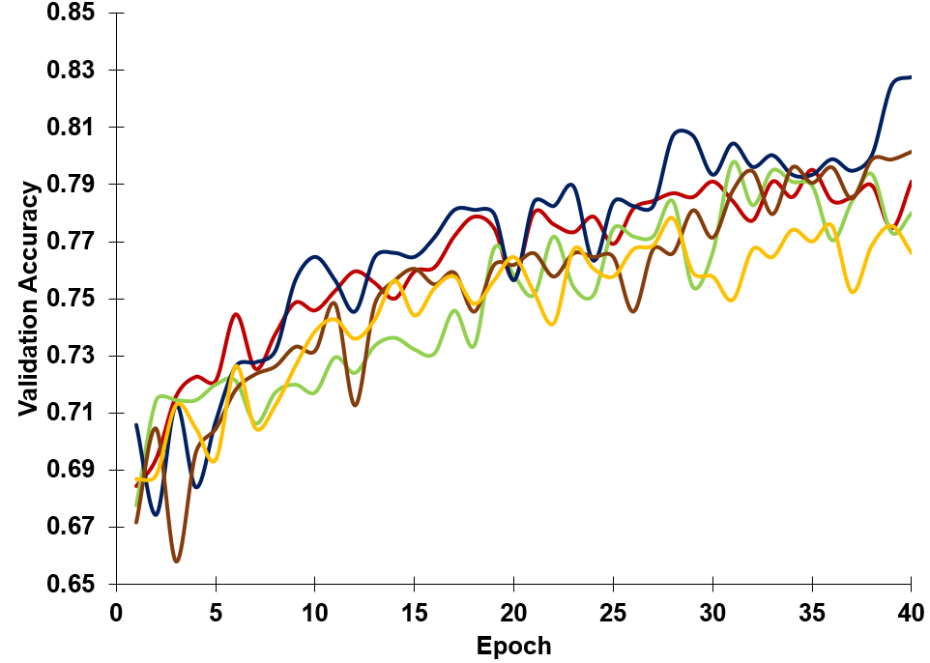
Severity detection

Slide 9
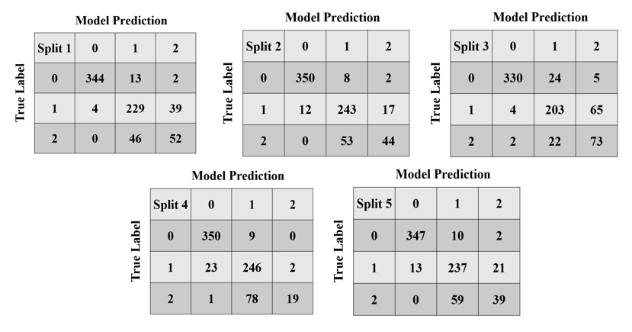

Slide 10
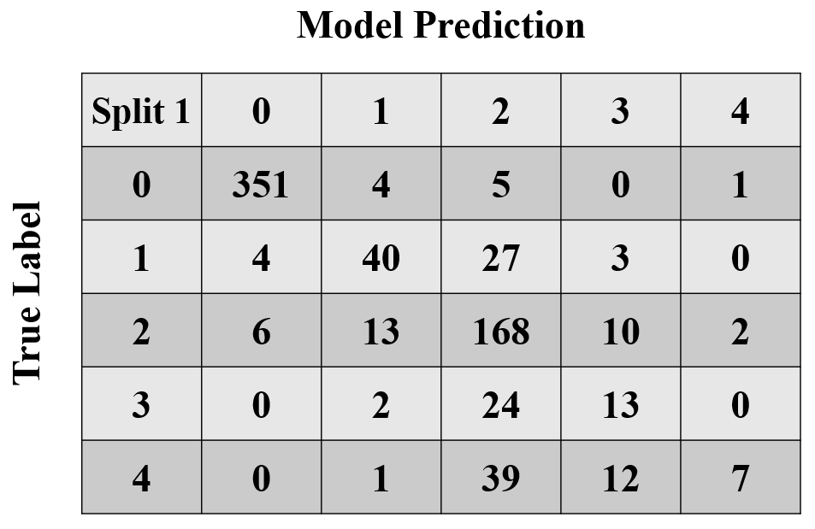
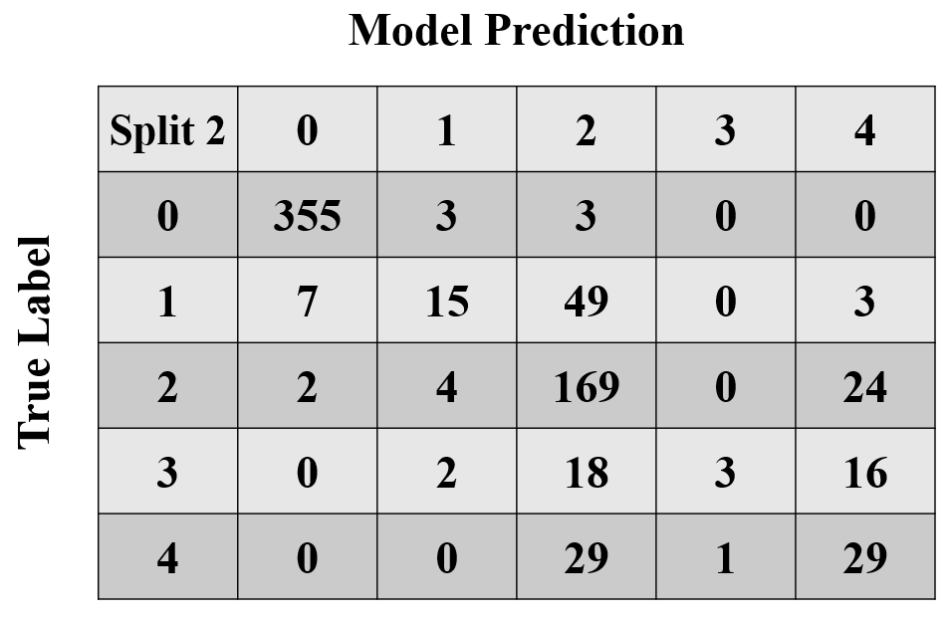
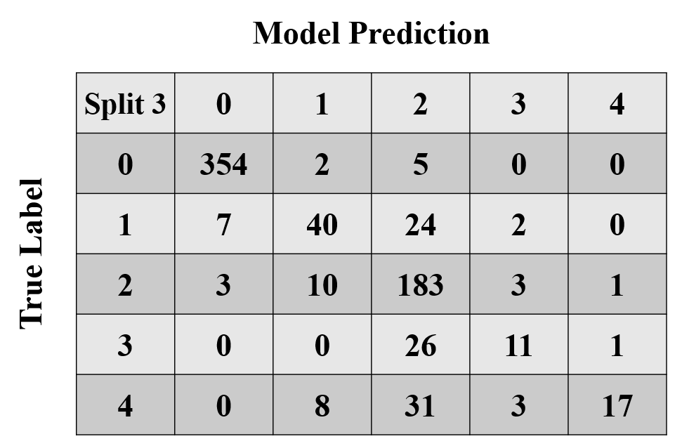

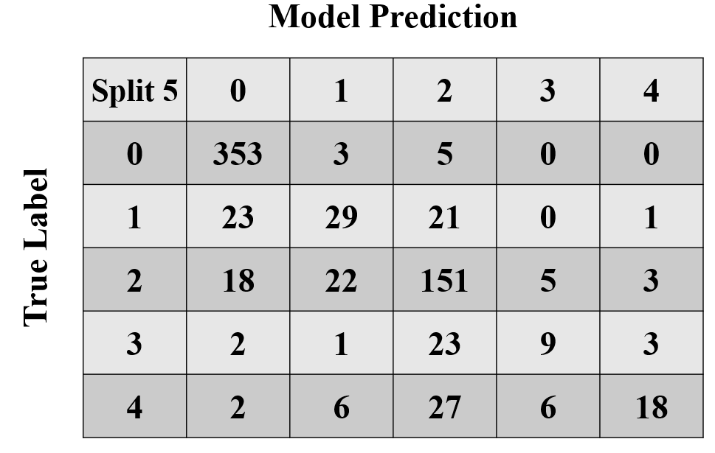
Severity detection

